Slide 1
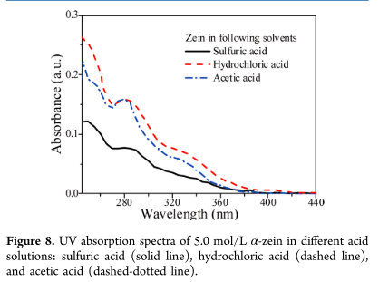
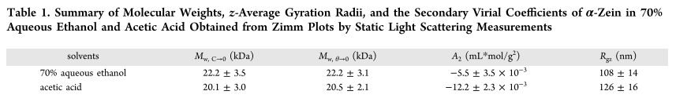
﻿Understanding the Dissolution of α‑Zein in Aqueous Ethanol and Acetic Acid Solutions
Zein is a corn protein that has been used as coatting, scaffold, nanoparticles, drug delivery etc.
The better quality for acetic acid than aqueous ethanol to dissolve zein is from additional protonation of the protein in the former solvent.
﻿The peak at around 280 nm corresponding to the aromatic rings in the protein, ﻿It suggests that zein can be dissolved in water with the addition of acids.
Yunqi Li et al. ”Understanding the Dissolution of α‑Zein in Aqueous Ethanol and Acetic Acid Solutions”, The journal of physical chemistry. 2012, 116, 12057-12064.

